Slide 1

Exploratory Data Analysis
Bank Marketing Campaign
Name: Samuel Alejandro Cueva Lozano
Email: samuelcl7@gmail.com
Country: Peru
Specialization: Data Science

Slide 2
Agenda
Executive Summary
Problem Description
EDA
Feature Selection
Model Recommendations

Slide 3
Executive Summary
Client: ABC bank: Portuguese banking institution
Problem Description: ABC Bank wants to sell it's term deposit product to customers and before launching the product they want to know whether a particular customer will buy their product or not (based on customer's past interaction with bank or other Financial Institution).
Business goal: Shortlist which customers have more chances to subscribe to the term deposit.
Dataset: https://archive.ics.uci.edu/ml/datasets/Bank+Marketing
Exploratory Data Analysis : Statistical data analysis will be performed on the Dataset
Descriptive analysis (univariate analysis)
Correlation analysis (bivariate analysis)
Qualitative analysis
Quantitative analysis
Feature selection and engineering
Feature selection based on descriptive analysis
Feature selection based on correlation analysis
Recommended models

Slide 4
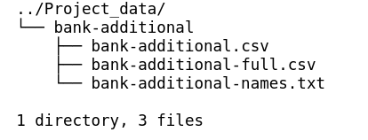
Data
The data is related with direct marketing campaigns of a Portuguese banking institution. The marketing campaigns were based on phone calls.
There are three files:
bank-additional-full.csv with all examples (41188) and 20 inputs, ordered by date (from May 2008 to November 2010).
bank-additional.csv with 10% of the examples (4119), randomly selected from bank-additional-full.csv, and 20 inputs.
bank-additional-names.txt with information about the attributes.
There are two files with data but since bank-additional.csv is in bank-additional-full.csv, this file will be ignored.

Slide 5
Attributes or features
Input features
bank client data
age (numeric)
job : type of job (categorical: 'admin.','blue-collar','entrepreneur','housemaid','management','retired','self-employed','services','student','technician','unemployed','unknown')
marital : marital status (categorical: 'divorced','married','single','unknown'; note: 'divorced' means divorced or widowed)
education (categorical: 'basic.4y','basic.6y','basic.9y','high.school','illiterate','professional.course','university.degree','unknown')
default: has credit in default? (categorical: 'no','yes','unknown')
housing: has housing loan? (categorical: 'no','yes','unknown')
loan: has personal loan? (categorical: 'no','yes','unknown')
Related with the last contact of the current campaign
contact: contact communication type (categorical: 'cellular','telephone')
month: last contact month of year (categorical: 'jan', 'feb', 'mar', ..., 'nov', 'dec')
day_of_week: last contact day of the week (categorical: 'mon','tue','wed','thu','fri')
duration: last contact duration, in seconds (numeric).

Slide 6
Attributes or features
Other attributes
campaign: number of contacts performed during this campaign and for this client (numeric, includes last contact)
pdays: number of days that passed by after the client was last contacted from a previous campaign (numeric; 999 means client was not previously contacted)
previous: number of contacts performed before this campaign and for this client (numeric)
poutcome: outcome of the previous marketing campaign (categorical: 'failure','nonexistent','success')
Social and economic context attributes
emp.var.rate: employment variation rate - quarterly indicator (numeric)
cons.price.idx: consumer price index - monthly indicator (numeric)
cons.conf.idx: consumer confidence index - monthly indicator (numeric)
euribor3m: euribor 3 month rate - daily indicator (numeric)
nr.employed: number of employees - quarterly indicator (numeric)
Output variable (desired target)
y - has the client subscribed a term deposit? (binary: 'yes','no')

Slide 7
Descriptive Analysis
Data types and missing values
Numerical attributes
Quantile Statistics
Descriptive Statistics
Distribution histograms
Outliers and tranformations
Feature Selection
Categorical attributes
Cardinality
Unique counts
Feature selection

Slide 8
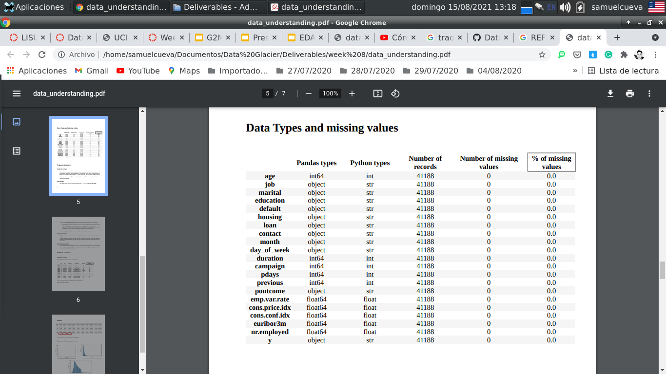
Data Types and Missing values
No missing values ​​found in the data set

Slide 9
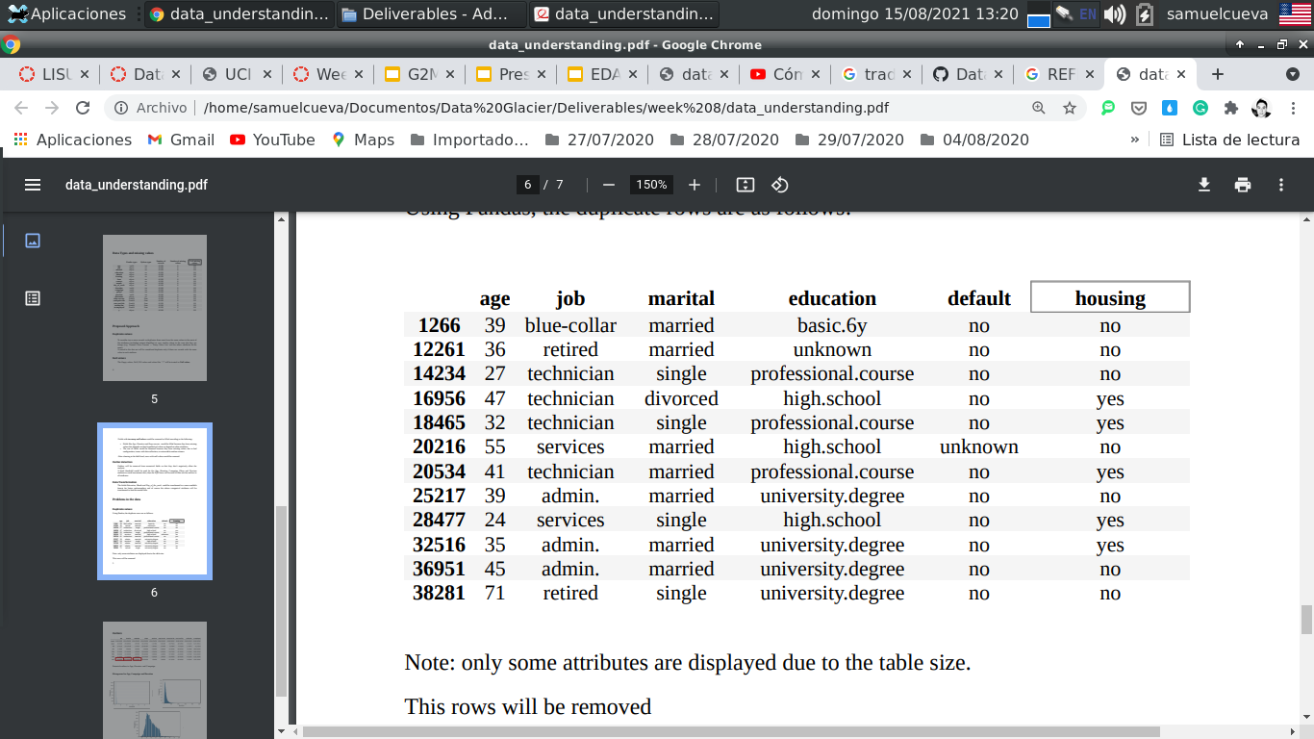
Duplicate values
These records are duplicates and will be removed
Note: only some attributes are displayed due to the table size.

Slide 10
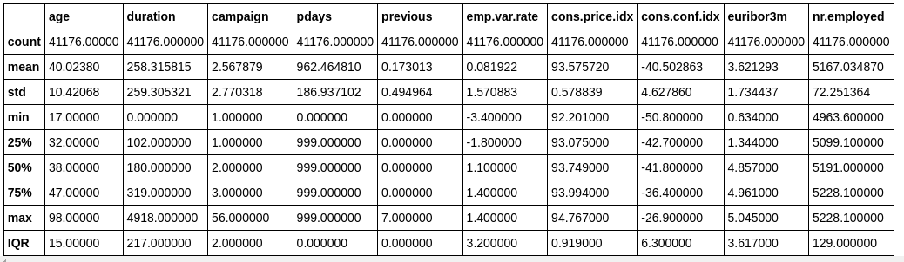
Descriptive Statistics
Low variance(std^2)
Potential outliers

Slide 11
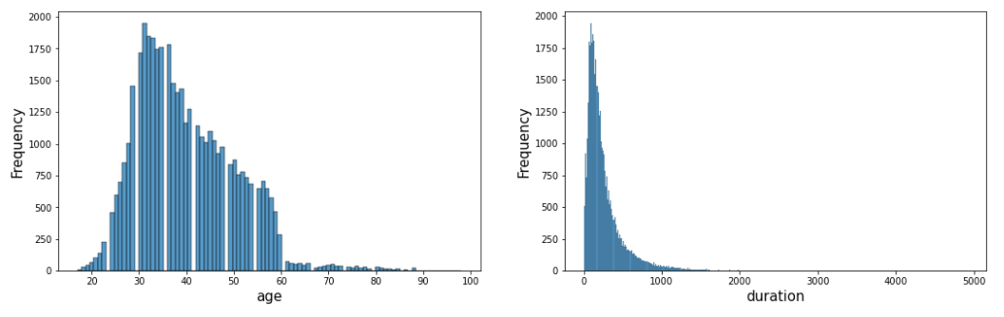
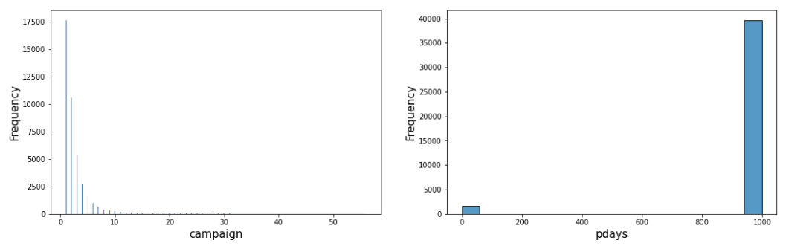
Histograms

Slide 12
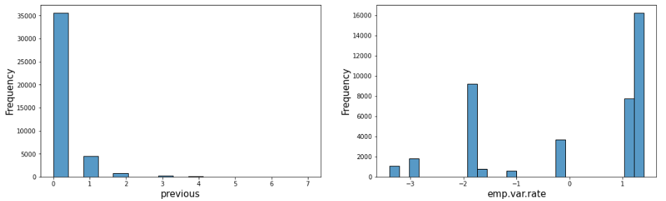
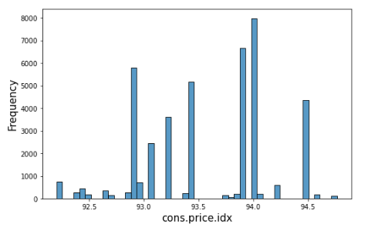
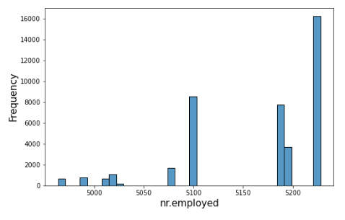
Histograms
In the graphics you can see the following:
The duration and campaign attributes have a skewed distribution which may be due to outliers.
The age attribute has a distribution that seems normal, but it also has a long tail shape. This may be because retired people are not contacted often.
Most of the people weren't contacted before, that's why the pdays attribute has that distribution.
The previous attribute has low variance, this means that most people were contacted between 1 and 4 times.
The emp.var.rate and nr.employed attributes have few different values.

Slide 13
Outliers
Approaches to dealing with outliers
Visualizations and descriptive statistics to detect potential outliers (done)
Filtering by fixed threshold
Clipping the attribute at a computed percentile ( 99%)
log of every value
IQR Score
The attributes with potential outliers are:
age, duration and campaign
Filtering by fixed threshold
There is not any attribute in which to apply this approach is reasonable.
The age attribute has a maximum value of 98 and this value is correct.

Slide 14
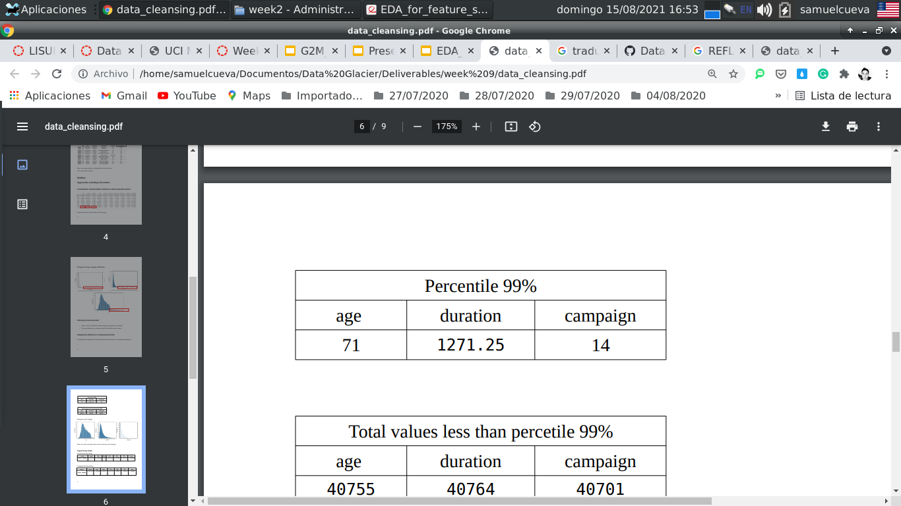
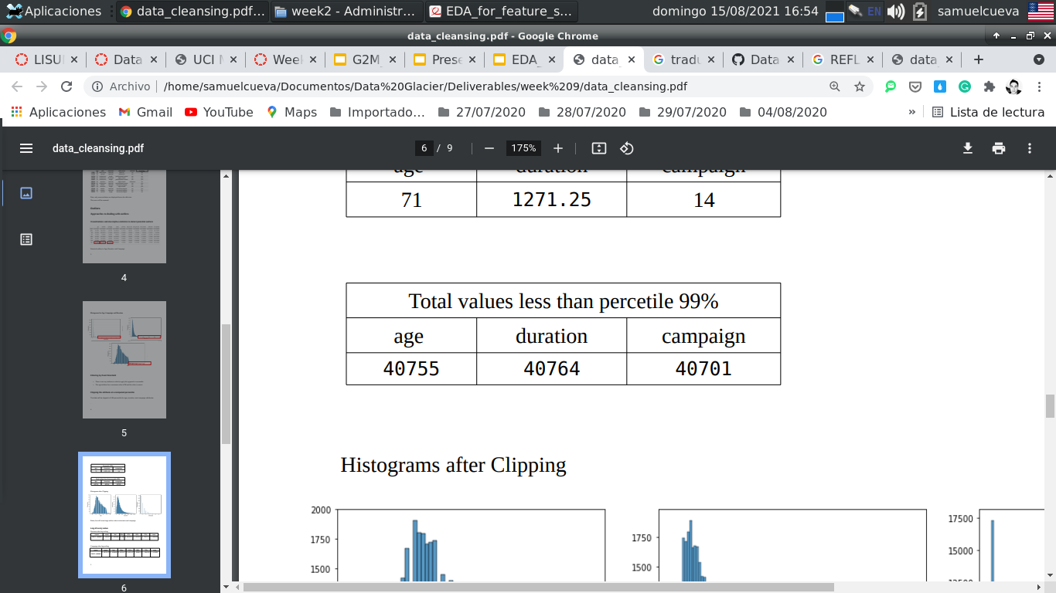
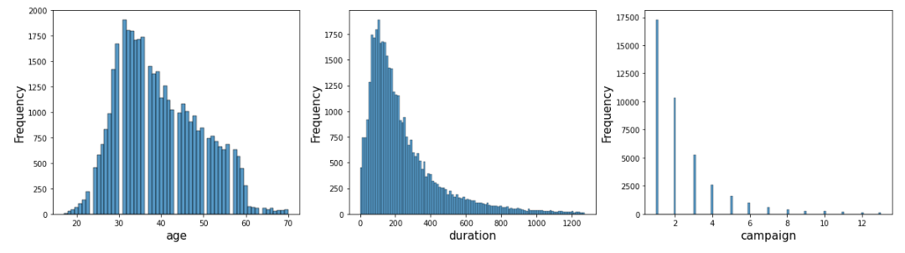
Clipping the attribute at a computed percentile(99%)
Histograms after clipping
Better, but there are
still many outliers in
duration and campaign.

Slide 15
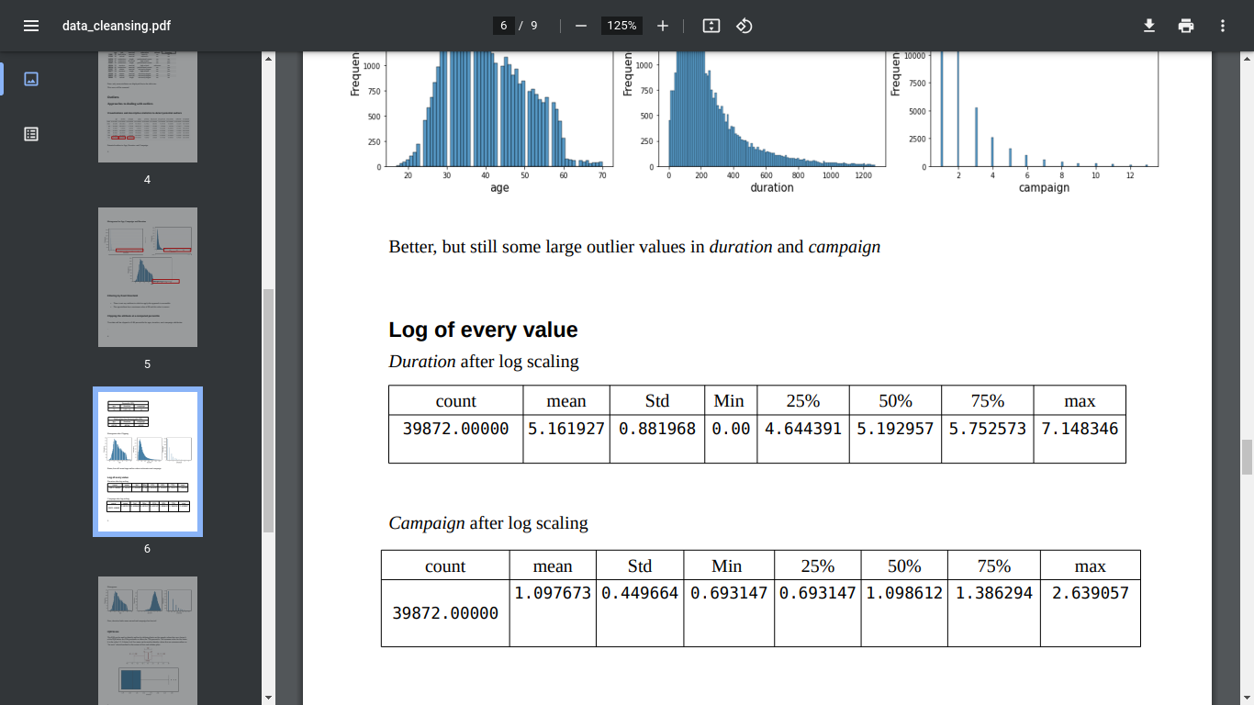
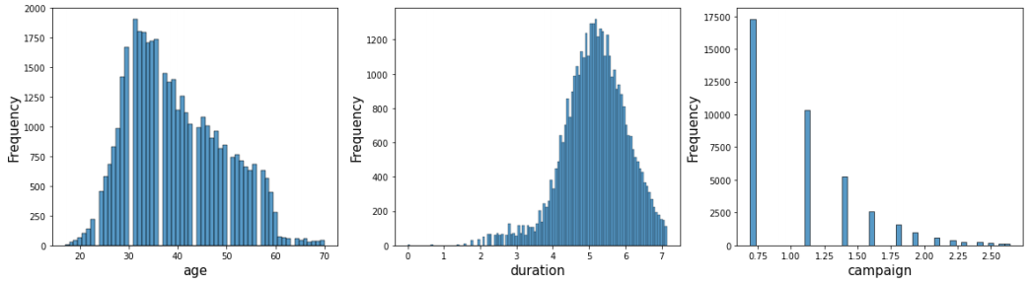
Taking the log of every value
Campaign after log scaling
Duration after log scaling
Now, duration looks more normal and campaign has less tail

Slide 16
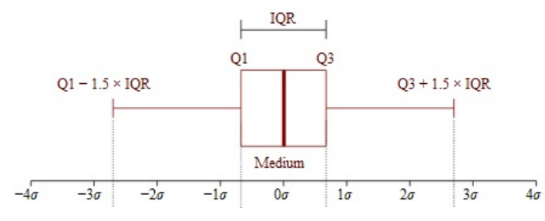
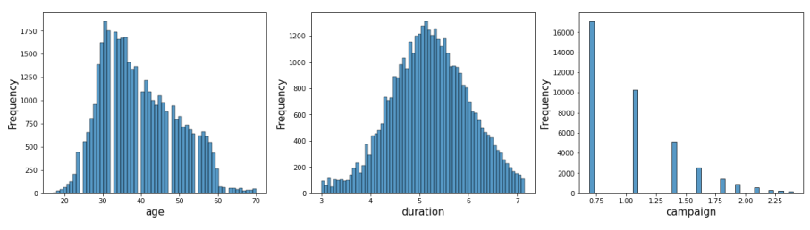
IQR Score
The IQR can be used to identify outliers by defining limits on the sample values that are a factor k of the IQR below the 25th percentile or above the 75th percentile. The common value for the factor k is the value 1.5. A factor k of 3 or more can be used to identify values that are extreme outliers or “far outs” when described in the context of box and whisker plots.
Now, our data is more useful than the original data

Slide 17
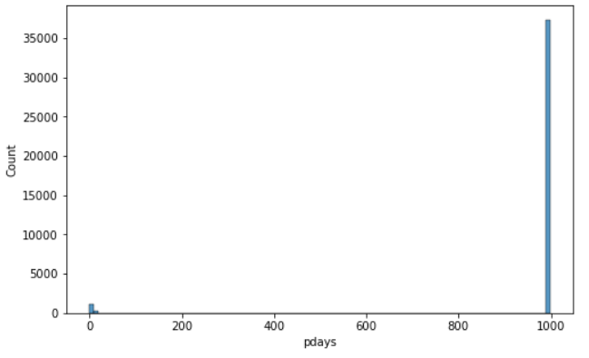
Transformation
Most of the people weren't contacted before, that's why most values are .
A new attribute will be created from pdays
discretizing pdays
bad | 0<= value <=3
good | 3< value <=7
excellent | 7< value <=30
fair | 30<value
unique counts pdays
bad | 37314
good | 588
excellent | 501
fair | 315

Slide 18
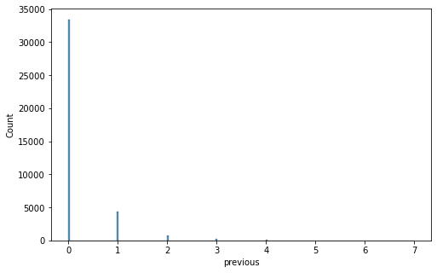
Feature Selection
After dealing missing values, duplicate values, outliers and transformations of numerical attributes, all numerical attributes will be preserved except previous.
Before previous attribute has very low variance, it will be removed since this will not harm the performance of the model, and it can reduce the complexity of the model.

Slide 19
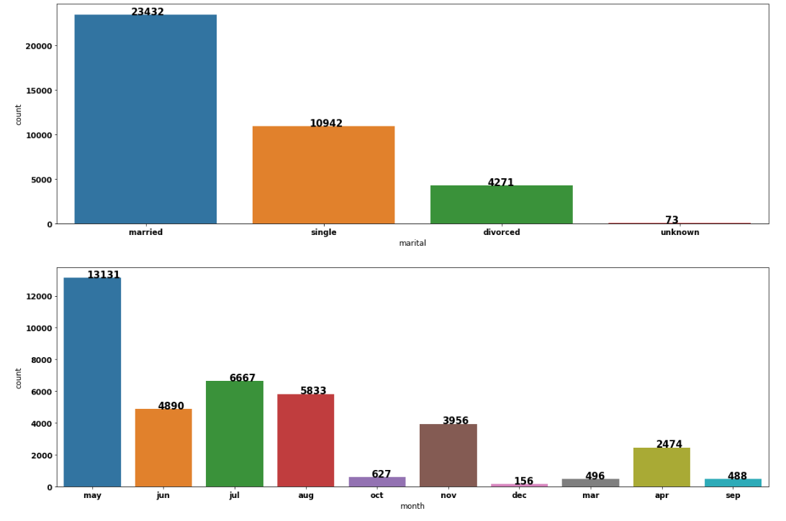
Cardinality and Unique counts
very few values
marital
month

Slide 20
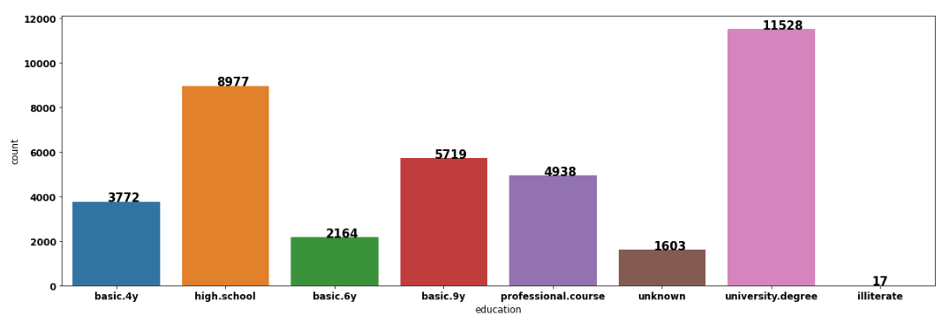
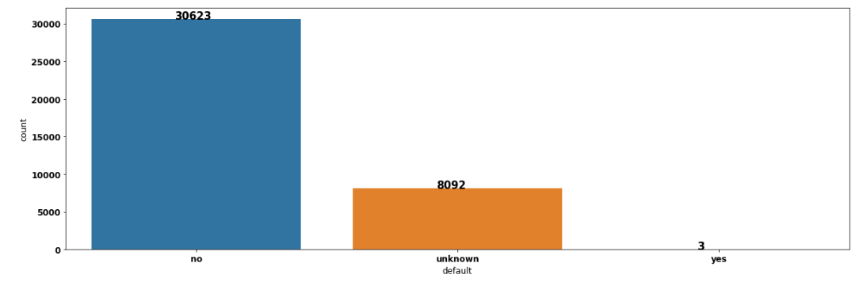
Cardinality and Unique counts
very few values

Slide 21
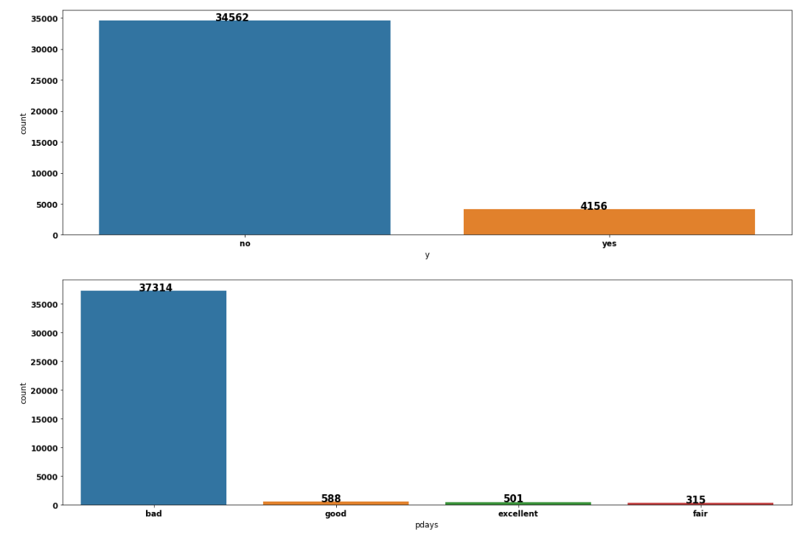
Feature Selection
pdays attribute will be removed because it has a very small entropy, which means that most of the records are in bad category.
The categories illiterate,yes and unknown will be removed from education, default and marital respectively.
The Target y has class imbalance and will be treated to mitigate the imbalance.

Slide 22
Correlation Analysis
Categorical vs Categorical
Numerical vs Numerical
Numerical vs Categorical

Slide 23
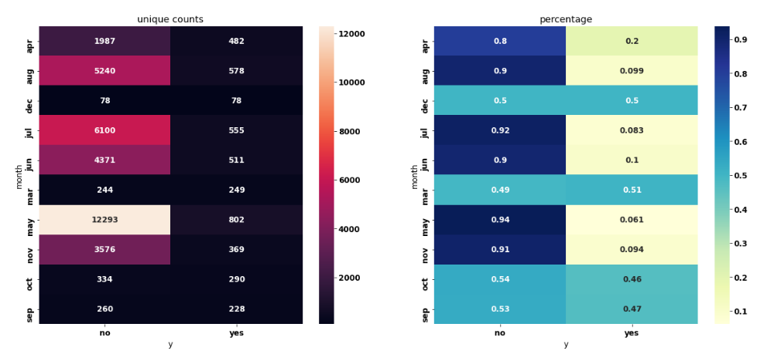
Categorical vs Categorical - month vs target

Slide 24
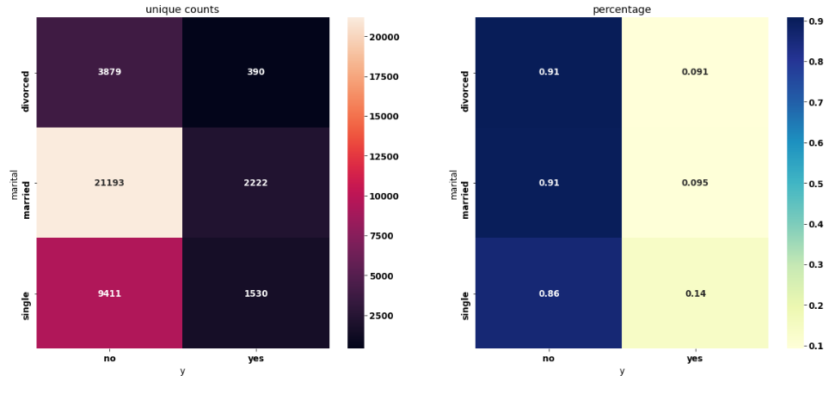
Categorical vs Categorical - marital vs target

Slide 25
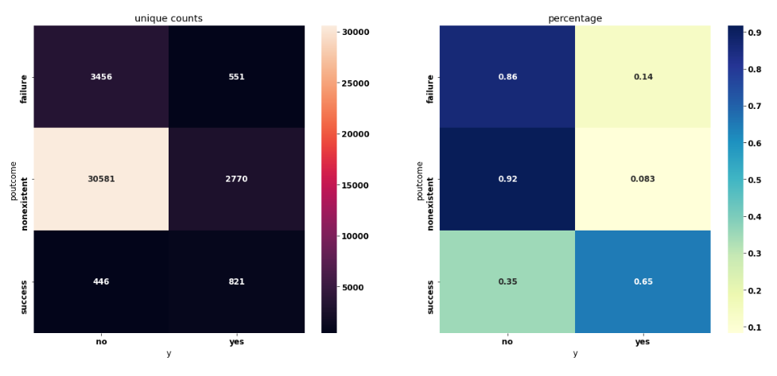
Categorical vs Categorical - poutcome vs target

Slide 26
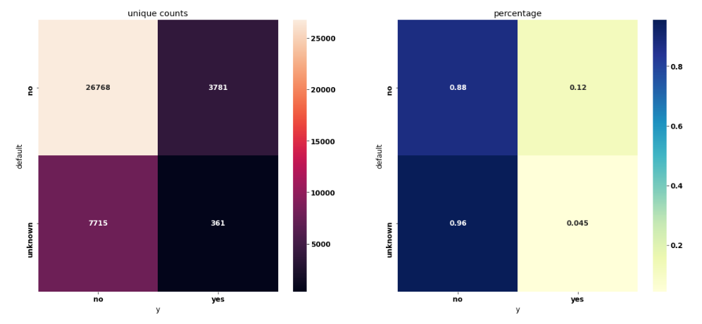
Categorical vs Categorical- default vs target

Slide 27
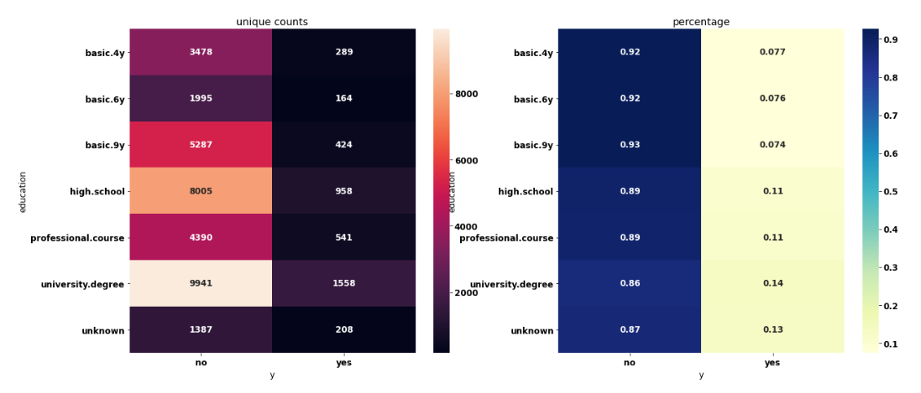
Categorical vs Categorical - education vs target

Slide 28
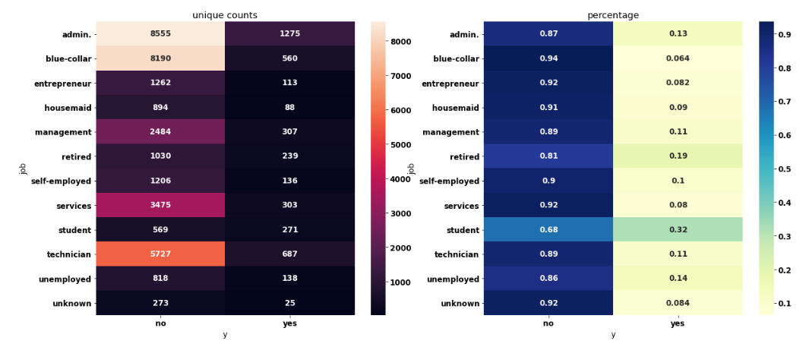
Categorical vs Categorical - job vs target

Slide 29
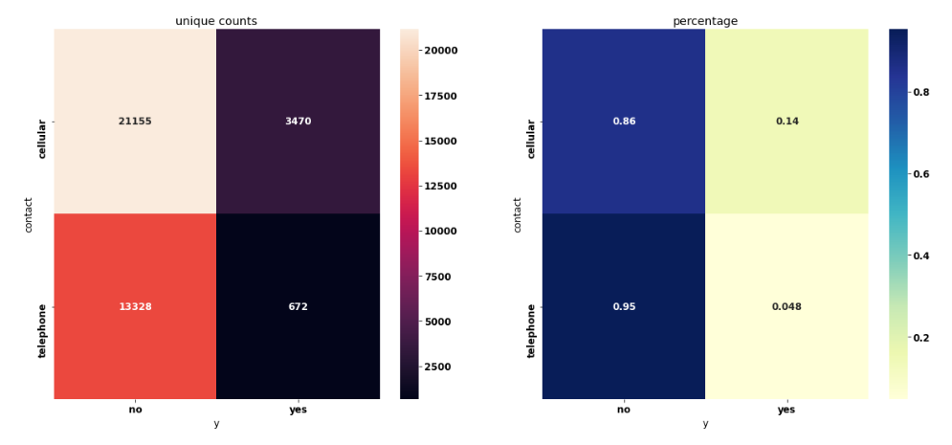
Categorical vs Categorical- contact vs target

Slide 30
Qualitative analysis - Insights
Based on the contingency tables (heat maps):
There is an apparent slight relationship between the marital attribute and the target y, as single people are more likely to subscribe to the product.
There is an apparent relationship between the default, job, contact, education, month, poutcome attributes and the target y.
The relationship between job, education and the target is intuitive.
poutcome is the output of the last campaign, so this attribute is the most predictive.
These relationships will be confirmed with a quantitative analysis.
The loan and housing attributes have no relationship with the target y, even though the 'unknown' category is removed in both attributes, the relationship is null. These attributes will be removed.
The day_of_week attribute has no relationship with the target y, it will be removed.

Slide 31
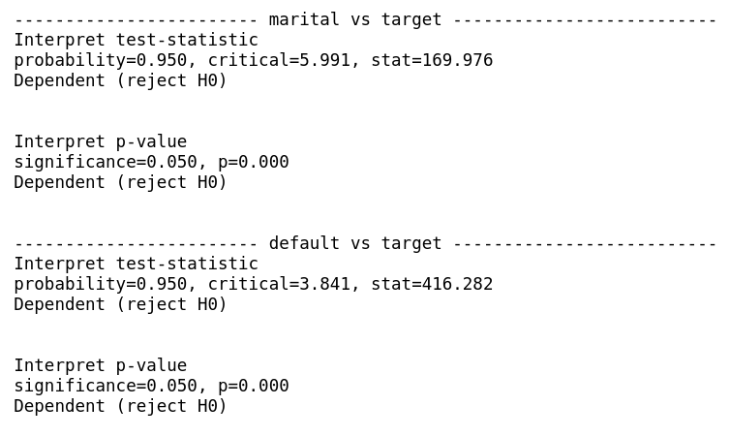
Quantitative analysis - Chi-squared Test
Interpretation
marital vs target: p-value< significance, both attributes are dependent, this means that there is a relationship between them.
default vs target: p-value< significance, both attributes are dependent, this means that there is a relationship between them.

Slide 32
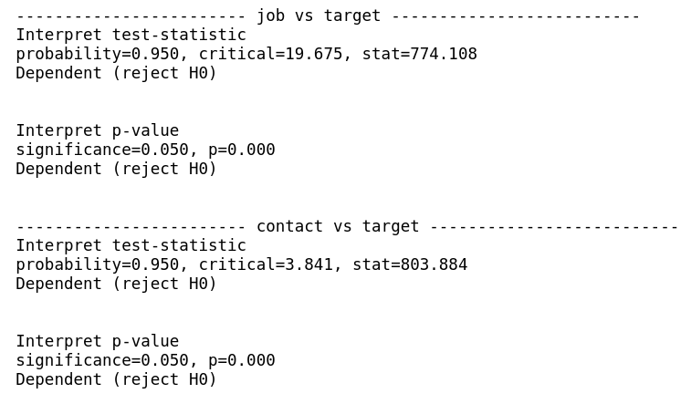
Quantitative analysis - Chi-squared Test
Interpretation
job vs target: p-value< significance, both attributes are dependent, this means that there is a relationship between them.
contact vs target: p-value< significance, both attributes are dependent, this means that there is a relationship between them.

Slide 33
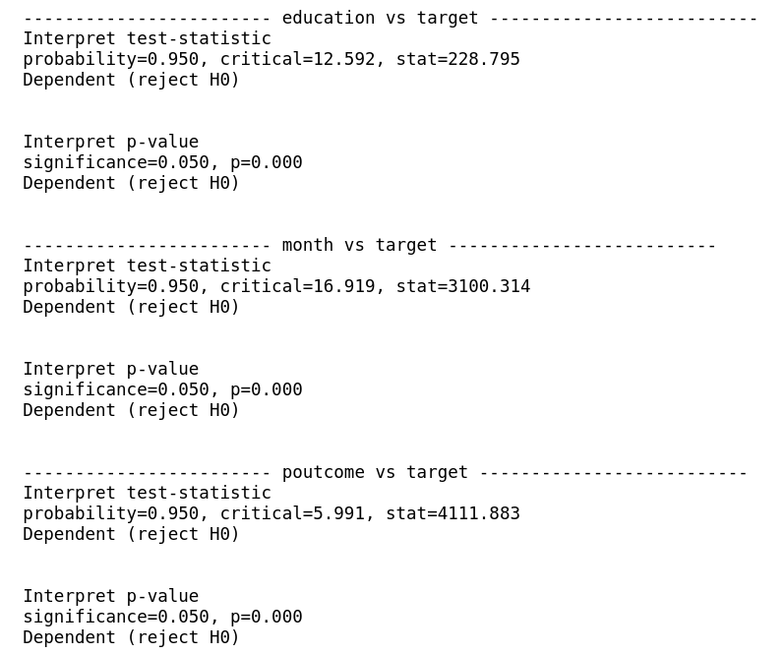
Quantitative analysis - Chi-squared Test
Interpretation
education vs target: p-value< significance, both attributes are dependent, this means that there is a relationship between them.
month vs target: p-value< significance, both attributes are dependent, this means that there is a relationship between them.
poutcome vs target: p-value< significance, both attributes are dependent, this means that there is a relationship between them.

Slide 34
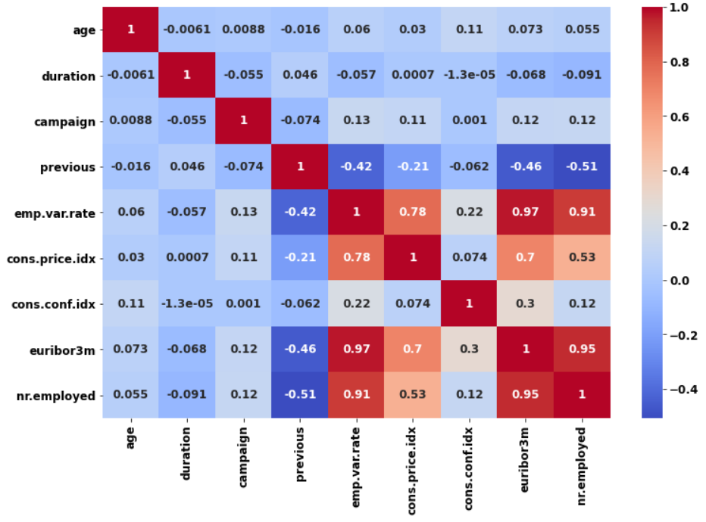
Numerical vs Numerical
Using the Heat map above, the following can be observed:
The previous attribute has high negative correlation with nr.employed,so the latter will be removed.
The emp.var.rate, euribor3m and cons.price.idx attributes have a high positive correlation between them, so euribor3m and emp.var.rate will be removed.

Slide 35
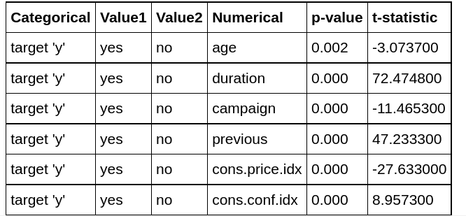
Categorical versus numerical
Student T-test
Taking a significance level of 0.05, this table shows that there is a strong correlation between the target y and all numerical variables.

Slide 36
Final Recommendations
After Exploratory Data Analysis and Feature Selection and Engineering, the features that should be fed to the model are:
Numerical:
age
duration
campaign
previous
cons.price.idx
cons.conf.idx
Categorical:
marital
default
job
contact
education
month
poutcome
Target:
y : Imbalance of categorical target, This problem will be addressed when building the model using different methods:
Oversampling minority class
Alternative metric and/or loss function

Slide 37
Model recommendation
algorithms | advantages | disadvantages
Logistic Regression | easy to train easy to implement | difficult to fit nonlinear data does not easily grasp complex relationships
Decision Tree | easy to interpret models complex relationships | bounded exploration of the variable space very simple
Neural Networks | models complex relationships high performance with large amounts of data | difficult to interpret
Random Forest | good exploration of variable space parallel work | more complicated to interpret than a tree
SVM | models complex relationships robust model against noise | difficult to interpret need processing power
XGBoost | high predictive power power other algorithms | black box

Slide 38
Thank You

